Slide 1
Amazon Sales Data Analysis
By Somil Taneja

Slide 2
Introduction
Sales management has gained importance to meet increasing competition and the
need for improved methods of distribution to reduce cost and to increase profits. Sales
management today is the most important function in a commercial and business
enterprise.

Slide 3
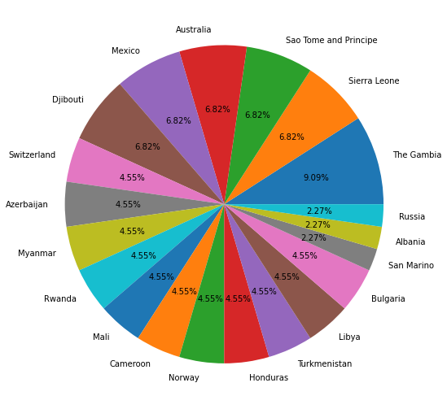
Top 20 countries

Slide 4
My Findings
Month-wise trend:
Total profit was maximum in February and April.
Total cost was max in October.
Total revenue was max in October.

Slide 5
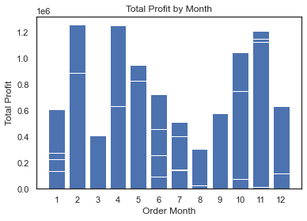
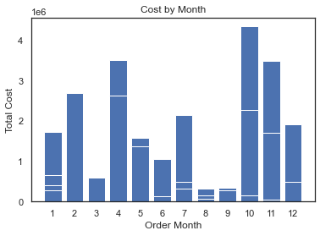
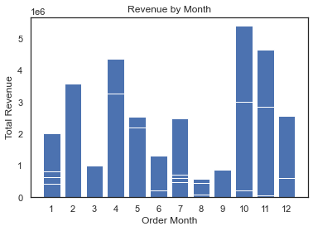

Slide 6
Yearly wise trend:
Total profit was max in 2010.
Total cost was max in 2010.
Total revenue was max in 2010.

Slide 7
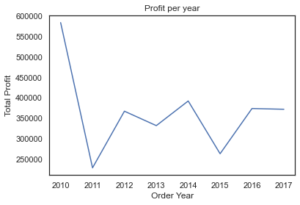
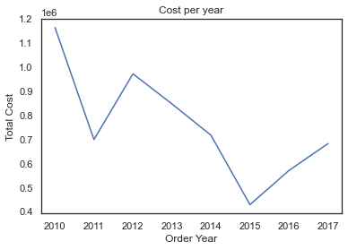
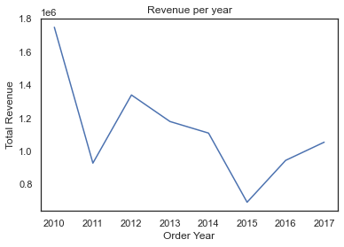

Slide 8
Yearly-month wise trend:
Total profit was max in 02/2015 and 10/2016.
Total cost was max in 02/2015.
Total revenue was max in 02/2015.

Slide 9
